Slide 1
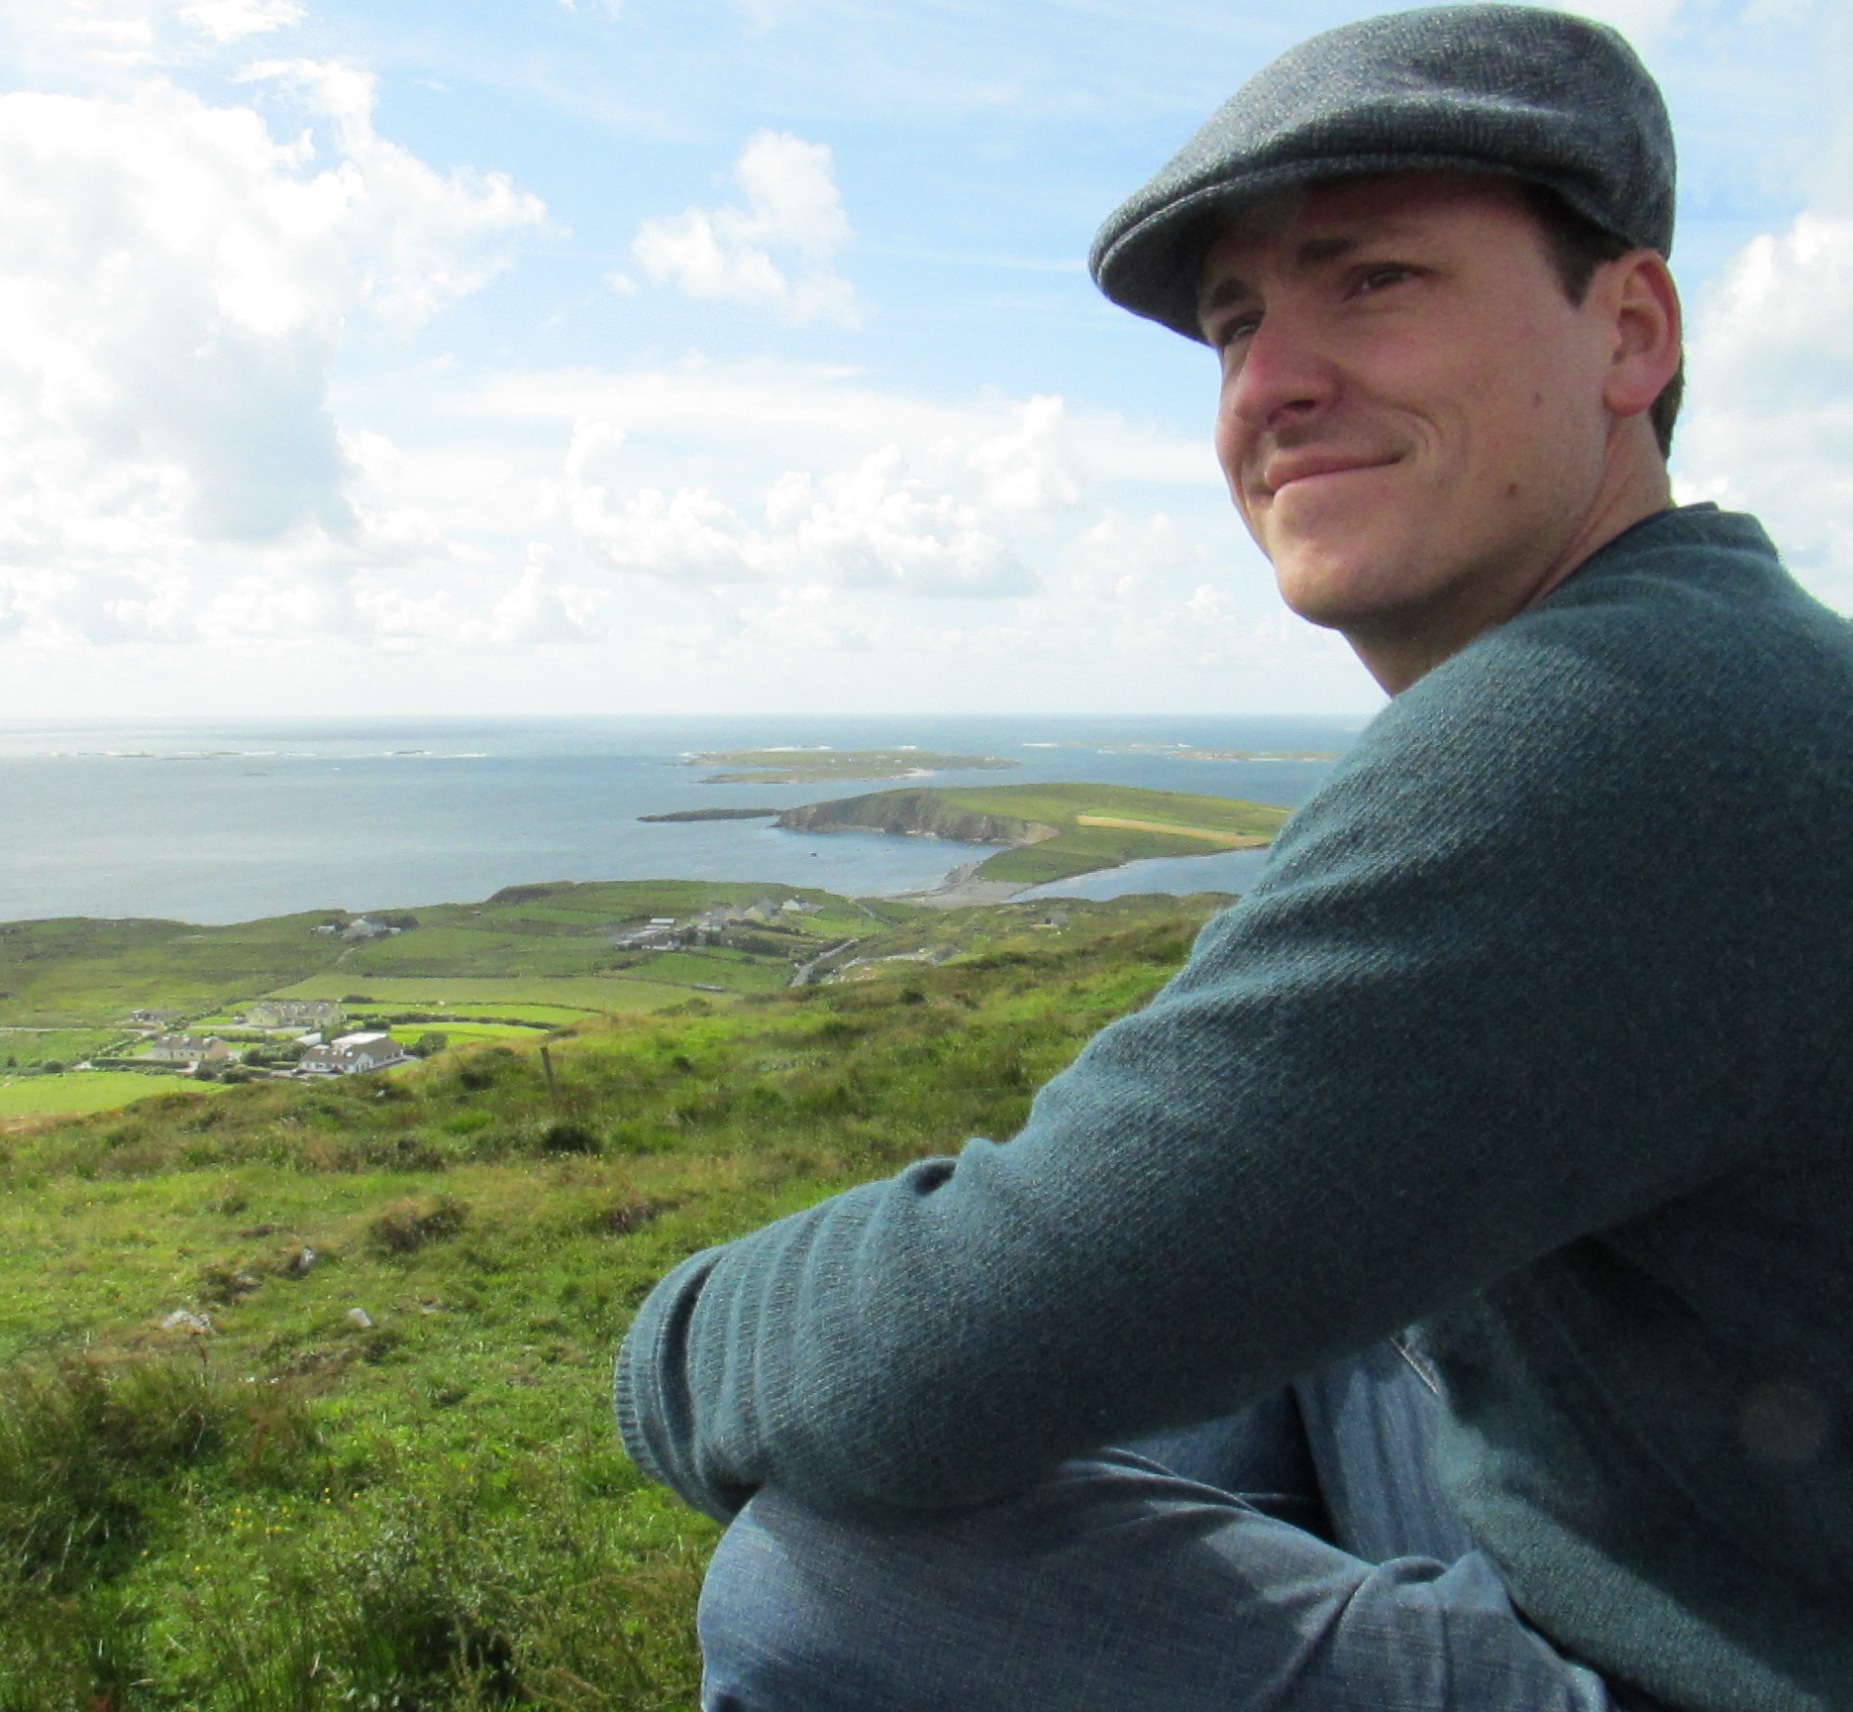
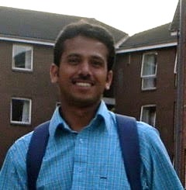
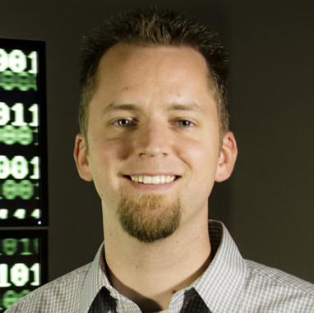


Journey to the Compute
Day 2: Compute Bound and Down, Container-ed Up and Truckin’
Based on work and publications by:
By: Blake Joyce
Upendra Devisetty
John Fonner
Tyson Swetnam

Slide 2

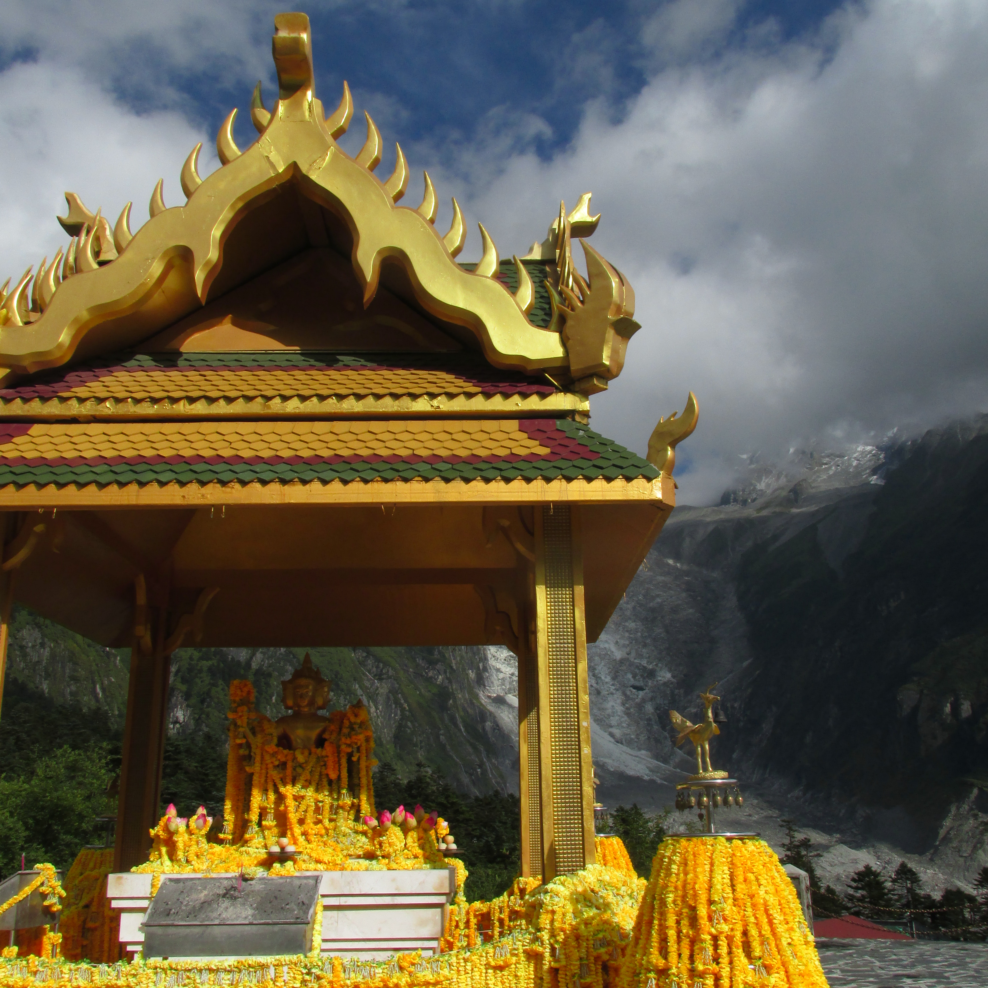
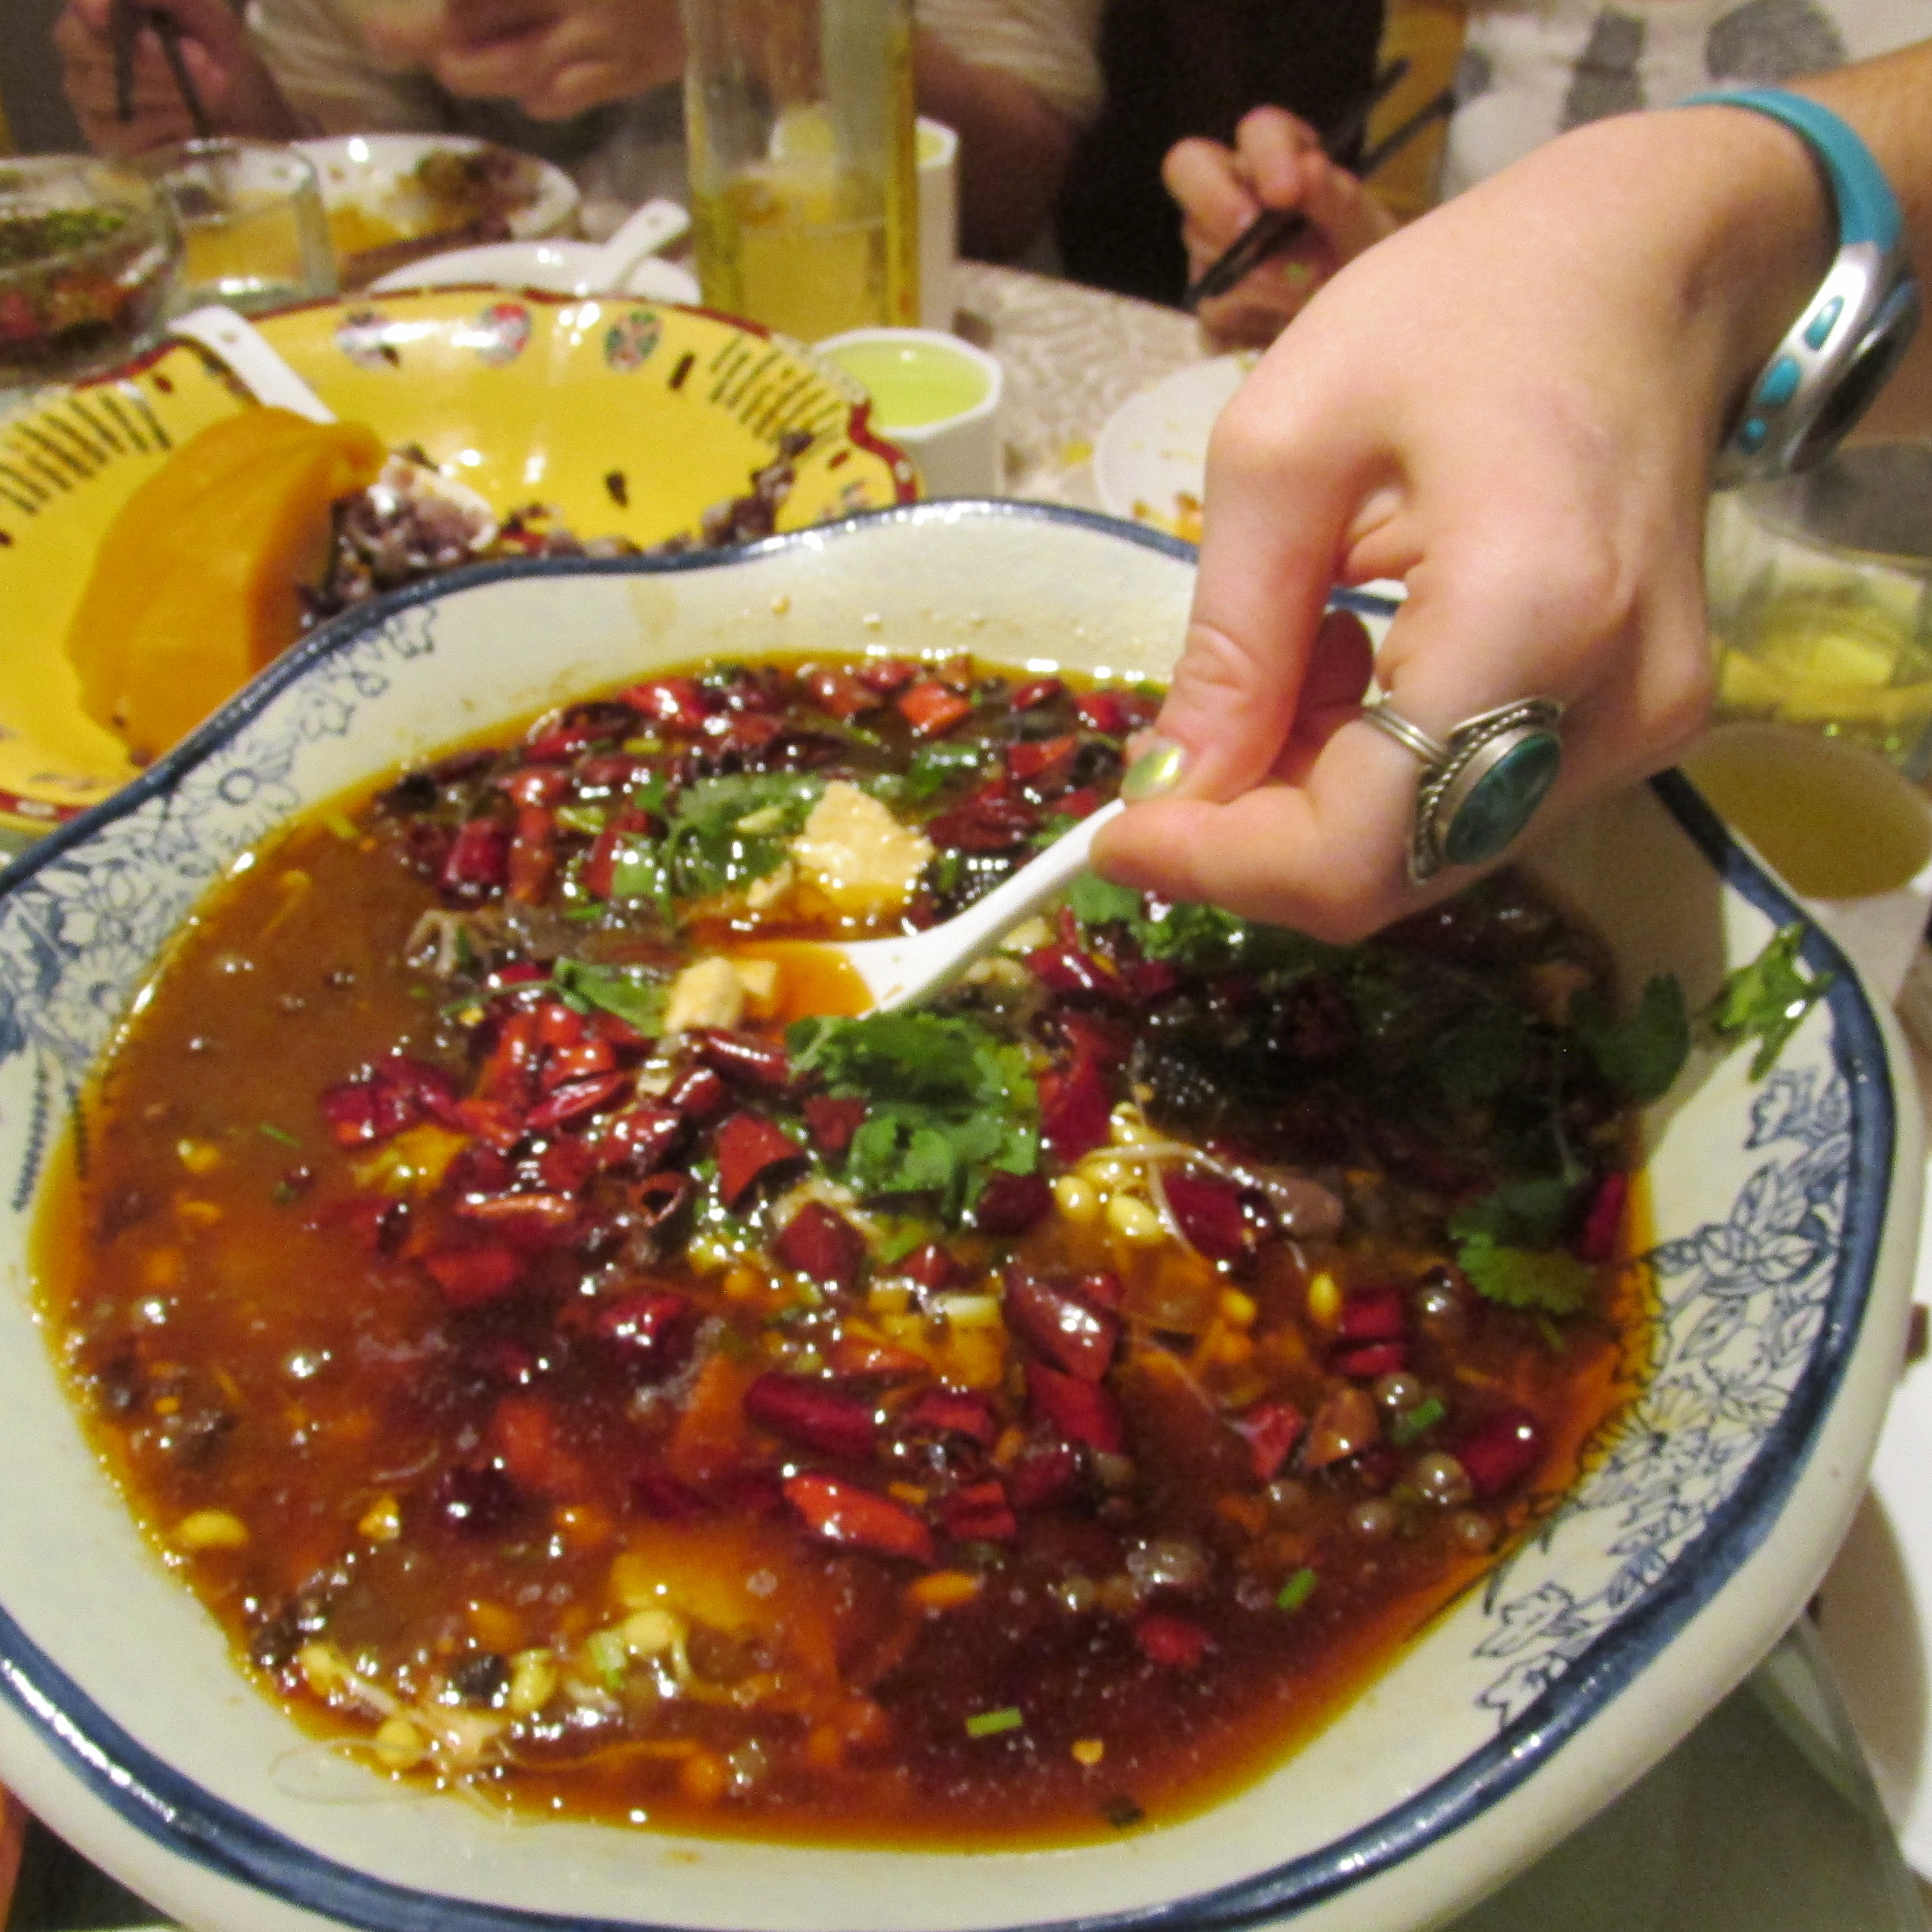
What We Are Really Interested In
FREEDOM!!! of compute resource choices
Easily leverage compute available
Wherever it may be
Because I want to live here
But work here
Get work done faster
HPC and Cloud Resources
Personal suggestion:
Use cloud for development
CyVerse Atmosphere: atmo.cyverse.org
Bioinformatic images available
`ez` install for several popular packages + dependencies
Move out to bigger compute through containers

Slide 3
Generalized Workflow
Here’s the standard thought process:
Local -> Docker -> Cloud
Local -> Singularity -> Cloud/HPC
Local -> Docker -> Singularity -> HPC
Reality: currently few prebuilt only Singularity containers for bioinformatics
Getting better though!

Slide 4
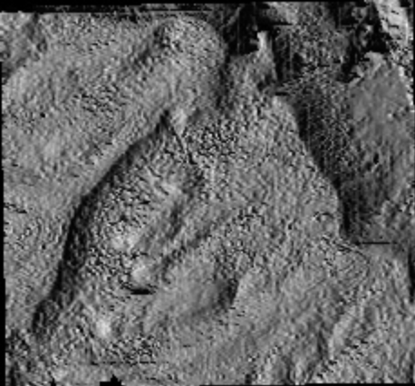
Testing on Local: Soaking up the rays
We’ll be working with a GIS package
365 ‘daily’ outputs for solar radiation and hours of light (example →)
12 ‘monthly’ net radiation
Please note:
This is a mature container project
But this is what’s possible
We’ll talk about how to start your own journey afterward
Container == Singularity
Work by: Tyson Swetnam (UA, CyVerse)
Mats Rynge (USC, Pegasus)

Slide 5
Introducing Singularity
Docker vs Singularity
Workflow in CyVerse
Login to Atmosphere (user.cyverse.org)
Workflow Elsewhere

Slide 6
Moving out: Local Computer → Cloud
Workflow in CyVerse
Login to Atmosphere (user.cyverse.org)
Launch an instance through GUI
Set up Docker/Singularity using `ezd`/`ezs`
Test container(s) with example data for tool using `docker run`
Test container(s) small amount of your data using `docker run`
Modify container as needed
Get a bigger instance (Jetstream?)
Workflow Elsewhere
Login to a cloud service
Figure out OpenStack
Launch using OpenStack
Pull Docker/Singularity package
Install Docker/Singularity
Test container(s) with example data for tool
Pull data from storage onto instance
Test container(s) small amount of your data!!!
Modify container as needed
Upload all data on an instance with more compute resources
`docker run` with tested arguments

Slide 7
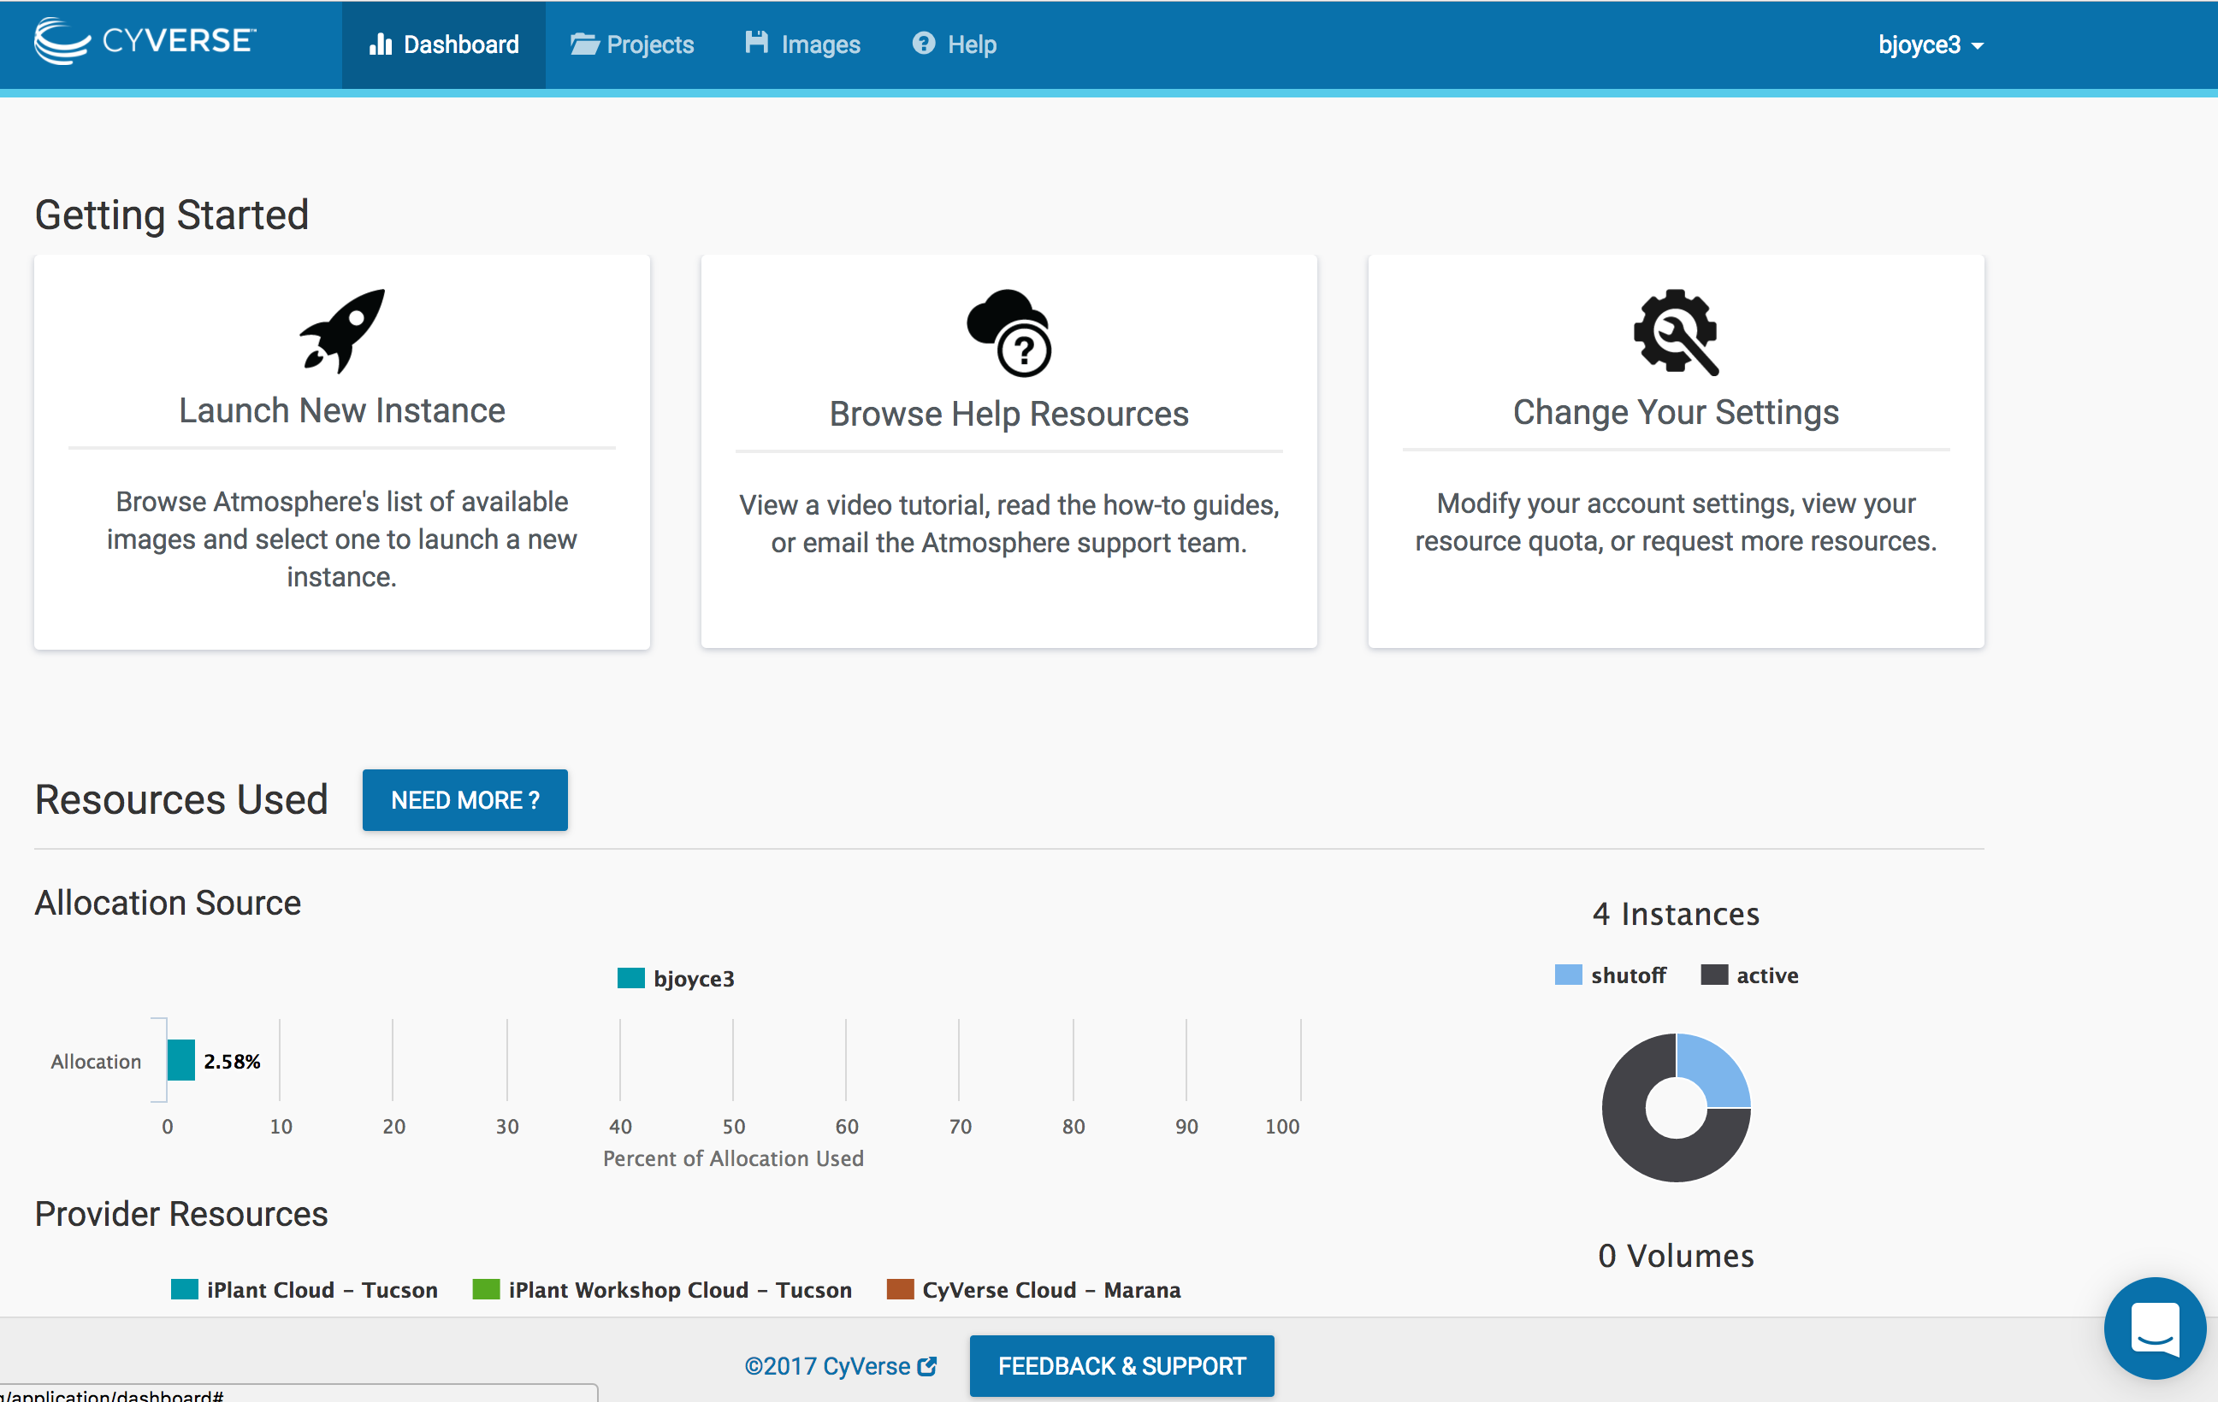
Local Computer → Cloud: Getting set up
Workflow in CyVerse
Login to Atmosphere (user.cyverse.org)
Launch an instance through GUI
Set up Docker/Singularity using `ezd`/`ezs`

Slide 8
Local Computer → Cloud: testing the container + data
Workflow in CyVerse
Test container(s) with example data for tool using `docker run`
Test container(s) small amount of your data using `docker run`
Modify container as needed
Get a bigger instance (Jetstream?)
Workflow Elsewhere
Test container(s) with example data for tool
Pull data from storage onto instance
Test container(s) small amount of your data!!!
Modify container as needed
Upload all data on an instance with more compute resources
`docker run` with tested arguments

Slide 9
Local Computer → UA HPC: starting the container
Workflow at UA HPC
Test container(s) with example data for tool using `docker run`

Slide 10
Let’s get crazy
Now we’re doing some real computational logistics
Typing/Seeing Screen on Local Computer
Atmosphere Instance
‘Master’
Singularity
Docker
Results
Results
UA HPC
Worker(s)
Atmosphere instance
Worker(s)

Slide 11
Hybrid: Cloud → Cloud + HPC
Commands found on the GitHub repo
Path: Journey_to_the_Compute/DayTwo/Code/commands_to_copy_execute.md
asdf
Notes:
Commands derived from Tyson Swetnam’s repos/repo wikis:
https://github.com/tyson-swetnam/sol-ot-comet-dev
https://github.com/tyson-swetnam/eemt-singularity-dev/wiki

Slide 12
Planning Your Journey
Insights from the Road

Slide 13
In Short: Containers First
It’s really about the containers
Set them up
Test them
Keep them with your data for reproducibility
If you’re in the academic world:
Treat containers like a publication
The de facto ‘Methods and Materials’ for analysis
Treat containers like an analysis package
But remember there’s more to reproducibility
Analysis package + DATA
I haven’t seen many slick tricks for data ← working on this
“Keep them public, keep them safe” – Everyone but Gandalf

Slide 14
Roll Your Own Container
Docker
Pull
Singularity
Login to a cloud service
It’s not feasible to go over this in a workshop format, but…..

Slide 15
(Rough) Guide to Scientific Compute
I NEED:
Flexibility
(Scale, Env Mods)
Specialty Compute
(GPU, high mem, etc.)
Cloud
HPC
Easy to Distribute uniform environment
(classes, workshops)
AKA Ghost computer, ether computer
This is what an HPC looks like in my mind

Slide 16
Scientific Compute Resources Available
CyVerse
XSEDE
Most Universities/Colleges have HPC

Slide 20
Journey to the Compute
Day 2: Compute Bound and Down, Container-ed Up and Truckin’
Based on work and publications by:
By: Blake Joyce
Upendra Devisetty
John Fonner
Tyson Swetnam

Slide 21
Let’s get to it
Opening syntax statement for command line things
Commands are encircled by `some command here`
Don’t actually type the first `, or the second `
Other things to change are <circled by these>
Likewise: don’t type this <, or this >
Bonus points: Use tab to autocomplete things like long paths
I’d start by cloning my GitHub repo:
Open your terminal/shell/bash/cigwin/whatever
cHANGE dIRECTORY to your desktop
Mac command: `cd` /Desktop/
git clone the repo
`git clone` https://github.com/bjoyce3/Journey_to_the_Compute
Seriously! Go For It! Yeah, right now!

